Slide 1


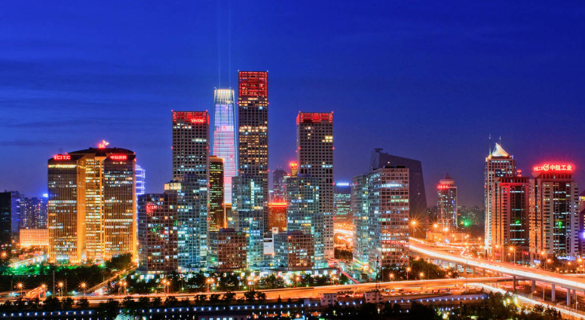
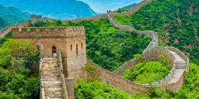
Beijing, China – Year 2
Things I should already know
Where the United Kingdom is on a map.
The countries of the United Kingdom.
The names of the seven different continents,
The names of the five different oceans.
People speak different languages around the world.
The difference between Human Geography and Physical Geography.
Word | Meaning
Asia | One of the seven continents of the world.
China | A country in Asia.
Beijing | A city in China.
Research | Using a book or the internet to find information.
Landmark | A famous natural or man-made object.
At the end of my learning I will:
Have researched Blackpool and explain its Human and Physical Geographical features.
Have researched Beijing and explain its Human and Physical Geographical features Explain what is the same about Beijing and Blackpool.
Explain what is different about Beijing and Blackpool.
Understand differences in Physical Geography between the UK and China.
Identify famous Chinese landmarks.

