Slide 1
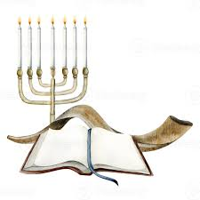
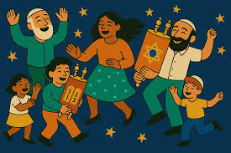
RE, Judaism – Year 5
At the end of my learning, I will know
The Torah is made up of the first 5 books of the Christian Bible.
How the Torah is Written, handled, stored.
Read and evaluate stories from the Torah, considering their lessons for Jews and how they help guide them.
How the festival of Simchat Torah is celebrated, and the importance of the Torah and Simchat Torah.
Reflect on something that is theirs that they wouldn’t want anyone to touch. Why? How can they ensure their wish is followed.
Pupils consider where they get their rules for life from.
Vocabulary
Torah | The most sacred holy book for Jews. It contains the first 5 books of the Hebrew Bible (Genesis, Exodus, Leviticus, Numbers and Deuteronomy)
Simchat Torah | A Jewish celebration each year, to mark the completion of the annual Torah reading cycle. Jews enjoy dancing, singing and lots of treats.
Hakata | Jews march around the synagogue’s central platform while carrying, singing and dancing with the Torah scrolls.
Synagogue | Jewish place of worship, study and community gathering.
Festival | A joyful event/ party to celebrate something special.
Commandments | God’s rule designed to keep believers safe, show love and help everyone get along together.
Things I should already know
How the festival of Hanukkah is celebrated.
How the festival of Sukkot is celebrated, including how the Jews build the Sukkah.
That Judaism, like other religions, use stories to teach how followers should live their lives.
How Jewish celebrations are similar and different from their own celebrations.

