Slide 1
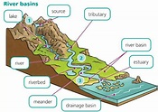
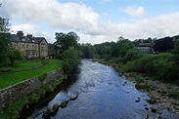
Rivers – Year 4
Things I should already know
There are different water features found on the Earth such as lakes, oceans, seas and rivers.
There are rivers in our local area.
Key Vocabulary
source | Where a river begins
Channel | The path of a river
Tributary | A small river that meets a large river
Mouth | Where the river enters the sea.
confluence | Where two rivers meet
Meander | A winding bend in the river
Estuary | The last section of the river before it meets the sea
Water cycle | The journey of water on the earth
Sea | A huge body of salt water
At the end of my learning I will know
Our local river is the River Ribble.
Complete a local river study.
•Rvers have sources, channels, tributaries and mouths, •
Rivers receive water from a wide areas and flows eventually into a lake or the sea.
The water flows naturally downwards, sometimes underground and eventually to the sea.
The River Nile was the main source of water in Ancient Egypt

