Slide 1
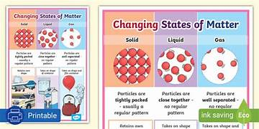
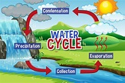
Mammals,
States of Matter & The Water Cycle Year 4
Things I should already know
Some materials can change shape when you squash, bend, twist or stretch them. Materials that are soft, bendy or stretchy are often easier to change the shape of than materials that are hard, rigid or strong.
The properties of a material affect their suitability, making them either suitable or unsuitable for particular uses.
Vocabulary
Evaporation | When the heat from the sun warms the water, the liquid turn into a vapour (gas) and rises because it is lighter.
Condensation | The water vapour is lifted into the sky. As you go higher, the air gets colder and cools down the gas. This causes the particles to condense (come together) and form micropscopic droplets of water.
Precipitation | As soon as the water droplets reach a certain size, their weight is too great to stay in the air and they fall down to the ground. This is called precipitation. If the air is very cold, the water falls as ice or sleet. Otherwise it galls as rain.
Collection | Wherever the water lands, this is called the ‘collection’ stage of the water cycle. Rain and snow may return to the Earth is rivers or lakes, on the ground or on houses and roads, where it soaks down towards the rivers. Eventually, most of this water flows into the seas. The water cycle can now start again!
States of Matter | Materials can exist in any of three states: solids, liquids or gases. Some materials can change from one state to another and back again.
At the end of my learning I will know
Increasing the temperature of a solid can cause it to melt into a liquid and eventually evaporate the liquid into a gas.
Decreasing the temperature of a gas can condense it into a liquid and eventually freeze the liquid into a solid.
How the Water Cycle works

