Slide 1
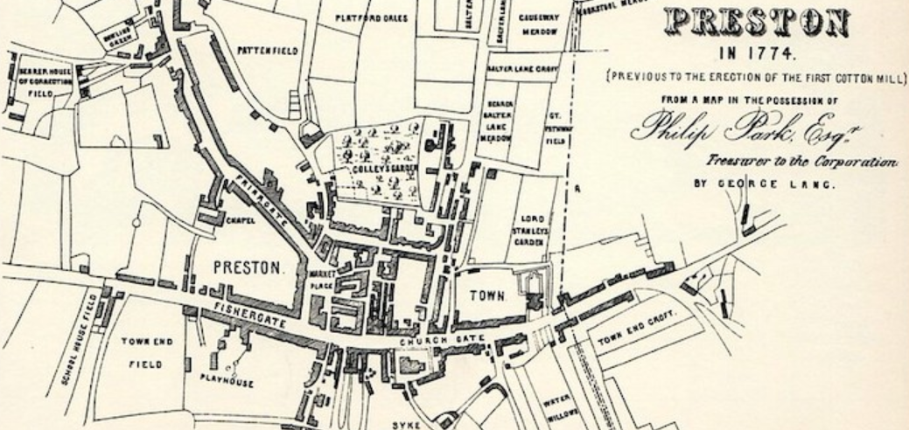

The Preston Guild – Year 2
Things I should already know
History is the study of things that have happened in the past
We learn about the past from sources such as diaries, stories, photographs and objects
We live in the city of Preston
Look at features of maps to explain how a place has grown and changed over time
Word | Meaning
Preston | The city where we live.
Preston Guild | A celebration that happens every 20 years.
Analyse | To carefully study something.
Evidence | Clues that tell us about the past.
Predictions | A sensible guess based on evidence.
At the end of my learning, I will:
Understand time as a concept.
Analyse evidence to see if we can trust it
Ask questions based on sources of evidence
Explain how Preston changed since 1179
Explain why Preston changed since 1179
Discuss what happens during the Preston Guild

