Slide 1
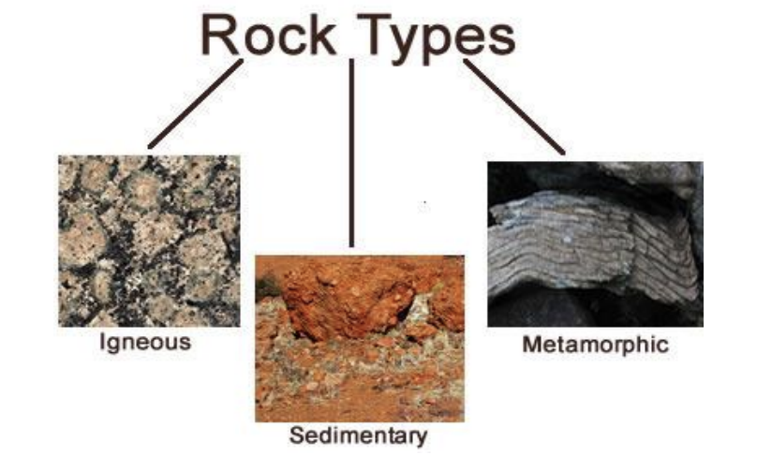
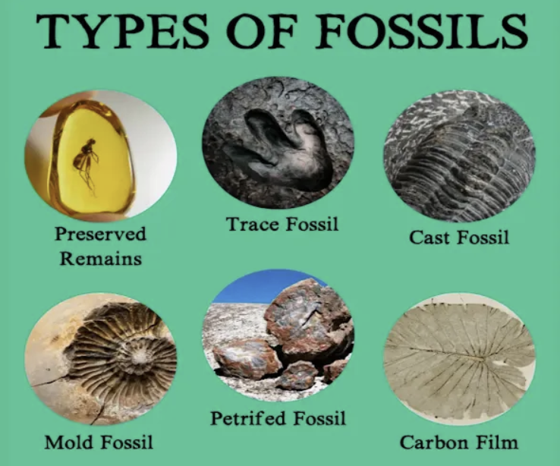
Rocks – Year 3
Things I should already know
Compare materials and describe why/how they are suitable for particular purposes​
Compare and group together a variety of everyday materials on the basis of their simple physical properties
Identify the suitability of a variety of everyday materials for particular uses.
identify and name a variety of everyday materials, including wood, plastic, glass, metal, water, and rock
At the end of my learning I will know
compare and group together different kinds of rocks on the basis of their appearance and simple physical properties.
describe in simple terms how fossils are formed when things that have lived are trapped within rock
recognise that soils are made from rocks and organic matter
Vocabulary
Permeable | Allowing liquids or gases to pass through it.
Impermeable | Not allowing fluid to pass through.
Soluble | A material, that when mixed with a liquid, breaks down into tiny particles that can’t be seen.
Preserved | Materials that don’t allow any light to pass through.
Sediment | Solid ‘bits’ of material, especially soil and pieces of rock, that have been carried along by water, ice or wind and then left (deposited) somewhere.
Fossils | The remains of animals or plants that have been preserved in rock.

