Slide 1
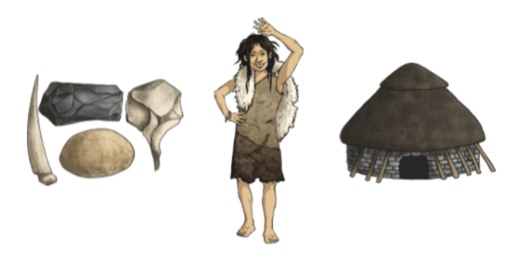
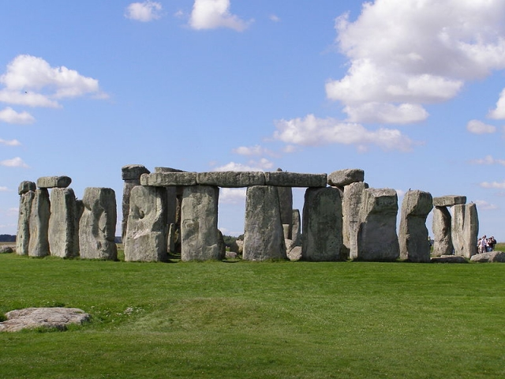
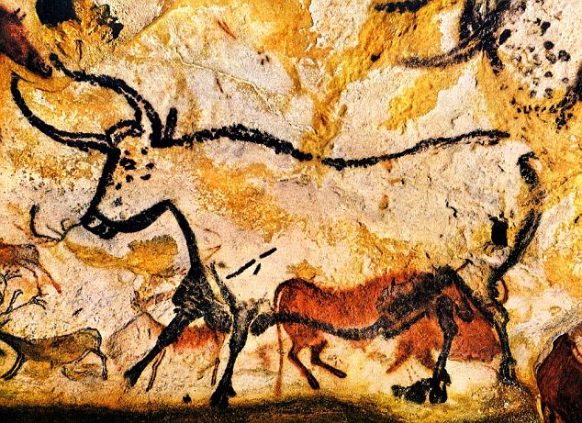
Stone Age Britain – Year 3
Things I should already know
History is the study of things that have happened in the past
We learn about the past from sources such as diaries, stories, photographs and objects
How my life has changed since I was a baby
The world has changed over the course of history
Analyse different sources of evidence
Ask questions based on sources of evidence
Make predictions based on sources of evidence.
Word | Meaning
Prehistoric | The time before written history began.
Palaeolithic | (Old Stone Age): An early period where people were hunter-gatherers using simple stone tools.
Mesolithic | (Middle Stone Age): A middle period when people developed finer tools and started fishing.
Neolithic | (New Stone Age): The final stage of the Stone Age, marked by the start of farming and permanent settlements.
Settlement | A place where a community of people builds a village.
Nomadic | Moving from place to place in search of food and resources.
Hunter-Gatherer | A person who hunts animals and gathers wild plants for food.
Artefact | An object made by a human, especially one of historical/cultural interest.
BC/AD | Before Christ/Before Common Era Anno Domini/Common Era
At the end of my learning, I will:
Chronological understanding: Understand that the Stone Age was a period of human history that preceded the Bronze Age and Iron Age, and how life changed during this time.
Human development: The shift from nomadic hunter-gatherer societies to settled communities and the development of farming.
Advancement in tools: Explore the use of stone for tools and weapons and the creation of megalithic structures made from large stones, wood, and earth.
Daily life: Investigate how people lived in the Stone Age, including what they ate, where they found food, and how they adapted to their environment.
Daily life: Investigate how people lived in the Stone Age, including what they ate, where they found food, and how they adapted to their environment.
Evidence and sources: Understand how historians and archaeologists use evidence, such as stone tools, bones, and footprints, to learn about prehistoric times.

