Slide 1
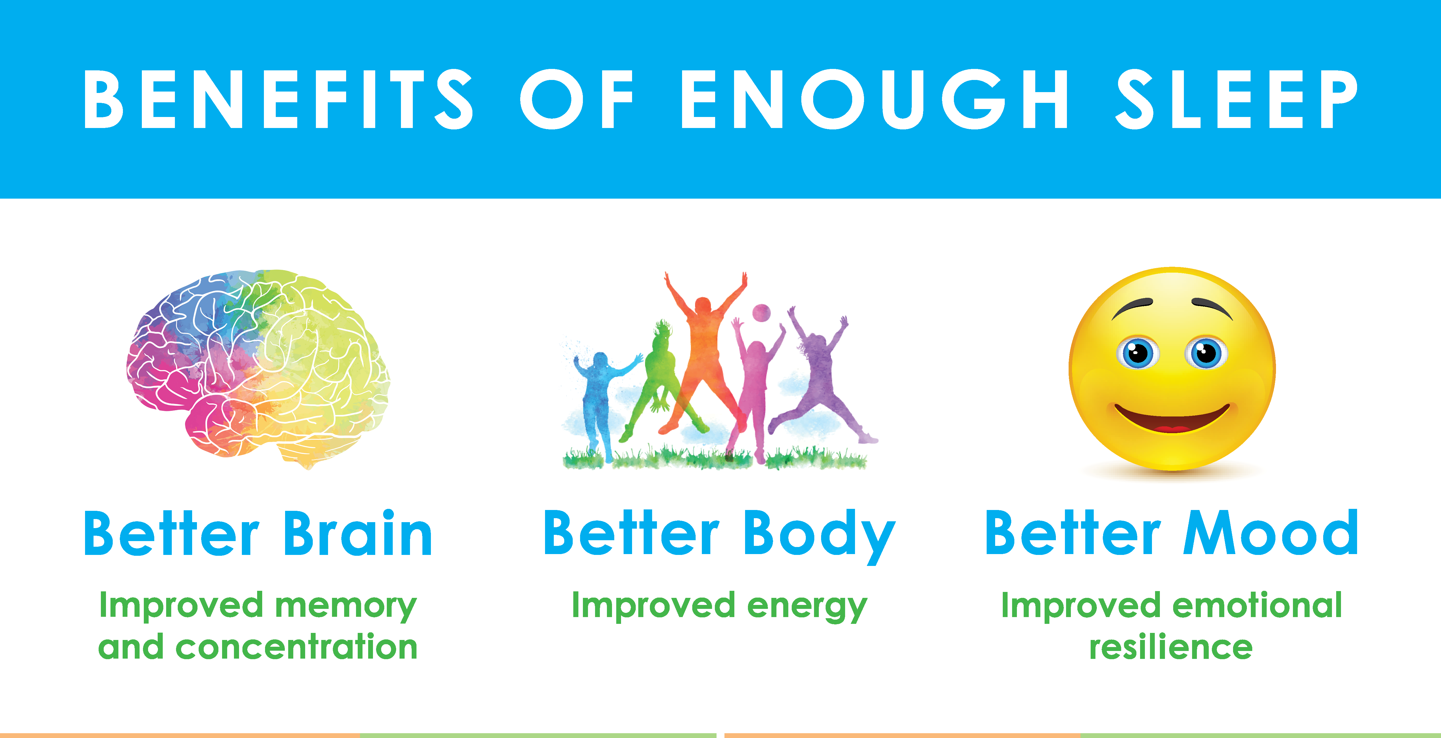
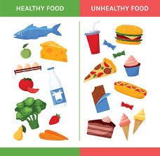
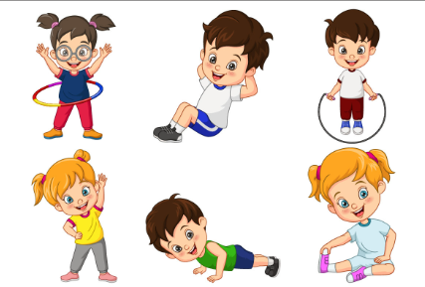
My healthy self: How can I take care of my mind and body?
Things I should already know
What it means to be healthy and why it is important
Ways to take care of themselves on a daily basis
Basic hygiene routines
Differences between healthy and unhealthy foods
Recognise what makes them special and unique including their likes, dislikes and what they are good at
How to manage and whom to tell when finding things difficult, or when things go wrong
How they are the same and different to others
About different kinds of feelings
Rules in the school, home & community
Word | Meaning
Habit | Something you do often without thinking (like brushing your teeth every day).
Exercise | moving your body to stay strong and fit.
Balanced diet | eating different types of food to stay healthy.
Hygiene | keeping your body clean to stay healthy.
Mental health
Physical health
At the end of my learning, I will:
Describe how our minds and bodies are connected.
Describe physical factors that can influence how a person feels.
Explain why sleep is important to maintain good mental and physical health.
Explain that emotions affect actions and decisions.
Describe ways to manage difficult emotions.
Recognise signs that someone needs help.
Identify trusted adults and appropriate actions.

