Slide 1
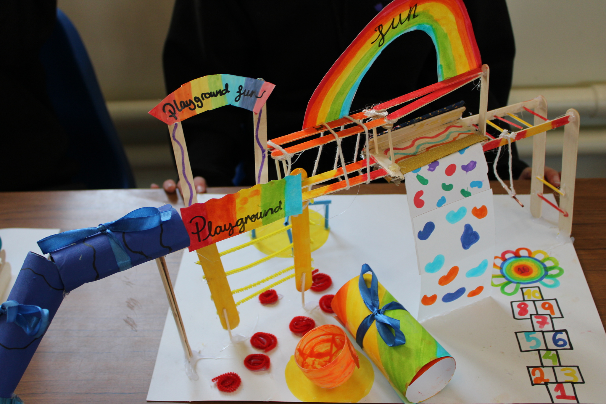
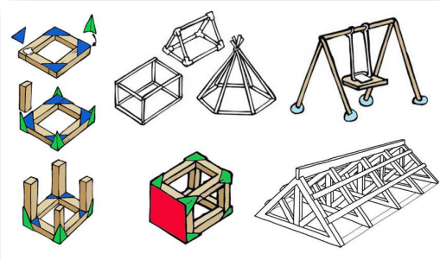
DT Structures, Playground – Year 5
At the end of my learning, I will know how to
Explain the term constraints and why some are more important than others.
Use sketches with labels to communicate ideas.
Choose from a range of my ideas and explain why.
Use an understanding of strength and stability to modify design.
Select appropriate materials and tools for cutting and joining.
Recall and follow safety instructions.
Reinforce and stabilise a structure.
Critically evaluate the success of a structure within constraints.
Suggest alternative materials that could be used to make a structure more sustainable.
Explain design decisions.
Vocabulary
Accessible | Something designed so that disabled people can use it safely and independently.
Constraint | A limit or condition when making a product.
Prototype | A model to show what a final product will look like or how it will work.
Sustainable | Using resources responsible so the planet is not damages or resources are not used up in the future.
Reinforce | To make something stronger by adding extra support or thicker materials.
Bracing | Adding extra pieces to stop a structure from wobbling.
Triangulation | Making a structure stronger by adding triangles or diagonal supports.
Aesthetics | How something looks.
Innovate | To develop new and creative ideas that improve something or solve a problem.
Things I should already know
Creating simple design criteria that outline basic functionality and appeal to individual users or target audiences.
Developing drawing and sketching skills with a focus on clarity and simplicity.
Creating prototypes using materials with similar properties to their final design.
Selecting equipment required for a series of tasks based on the plan. Explain why each piece is suitable for each stage.
Following detailed safety instructions

