Slide 1
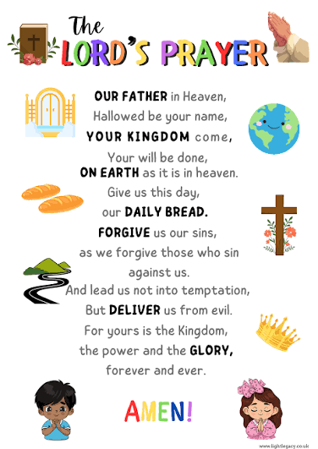
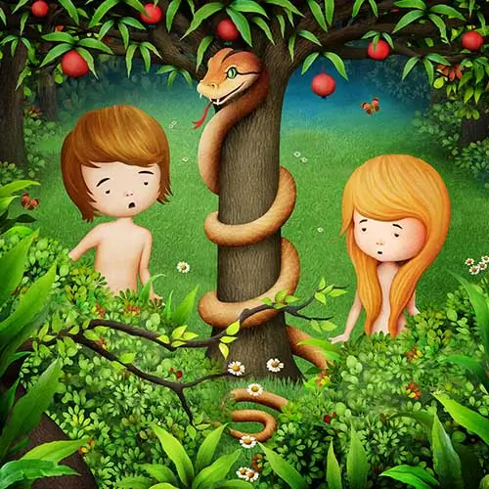
RE, Christianity ‘God’– Year 5
Vocabulary
Forgiveness | Choosing to let go of angry or hurt feelings when someone makes a mistake or does something wrong to you.
Sin | Doing something on purpose or by accident that breaks God's rules, hurts others, or goes against what is right.
Prayer | A special way of talking and listening to God or a higher power.
Guidance | Getting helpful advice, direction, or leadership from someone who has more experience.
Temptation | A strong feeling of wanting to do or have something, even though you know it is wrong, unhealthy, or against the rules.
Confession | When you tell the truth about something you did wrong or share a secret you kept hidden.
At the end of my learning, I will know
Describe Christian beliefs about sin and forgiveness
Explain the teaching from Genesis 3 – of how Adam and Eve disobeyed God and suggest different ways that this story might be understood by Christians.
Describe and explain how and why Christians might use the Lord’s Prayer
Analyse and interpret the Lord’s Prayer – and what guidance it provides for Christians
Suggest things that might lead Christians into temptation in the modern world – and how and why they might try to resist these temptations
Things I should already know
That Christians often talk or pray to God.
Why Christians believe the 10 commandments are important and the importance of rules in everyday life.
The story of Moses and how his qualities made him a good leader.
That Christians believe that God created the world

